Slide 1
Data Preprocessing
Random Forest Classification Model
K Nearest Neighbors Model
Logistic Regression Model
Lasso Regularization
K-Fold cross validation
Step 1: Build The Models
Step 0: Cleaning, Visualization and Exploratory Analysis for Machine Learning
PCA
+Random Forest
+KNN
T-SNE
+Random Forest
UMAP
+Random Forest
Step 2: Dimensionality Reduction
Breast Cancer Dataset
Agglomerative
K-Means
Affinity Prop
DBSCAN
+PCA
+T-SNE
+UMAP
Step 3: Clustering
My Jupyter Notebook
Data Preprocessing
Linear Regression Model
+Lasso
Random Forest Regression Model
Facebook Metrics Dataset
Step 0: Cleaning, Visualization and Exploratory Analysis for Machine Learning
Step 1: Build The Models
Agglomerative
K-Means
Affinity Prop
DBSCAN
+PCA
+T-SNE
+UMAP
Step 3: Clustering

Slide 2
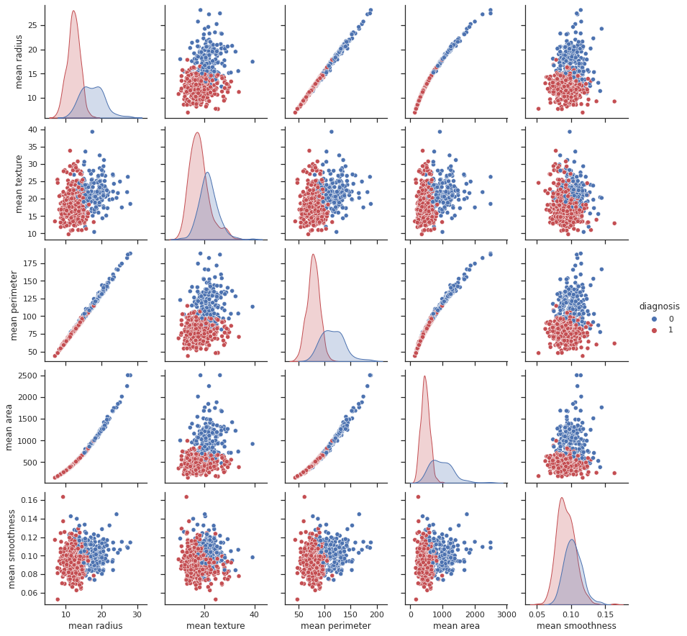
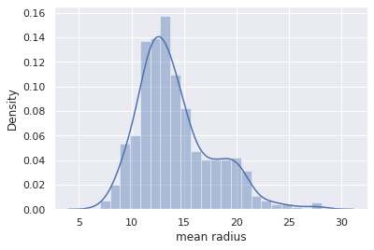
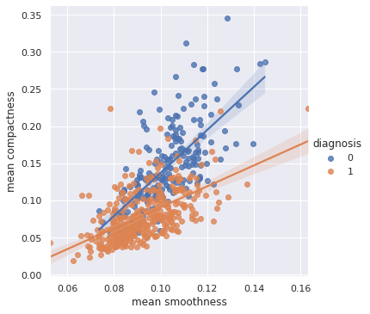
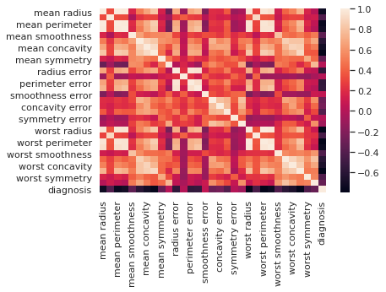
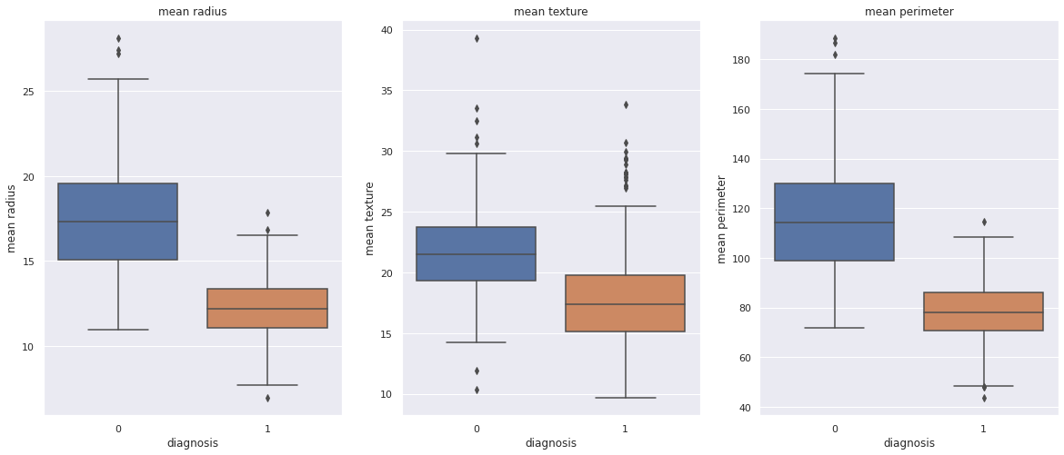
Breast Cancer Dataset
Step 0: Cleaning, Visualization and Exploratory Analysis for Machine Learning
Renamed ‘target’ to ‘Diagnosis’
Checked for existence of Categorical values
Checked for unique values in each column
Checked for NaN values
Checked for rows with missing data
Calculated the the null model (always predicting "Breast Cancer") as 62.5%
and any meaningful model that improves performance will have to break that accuracy score. MUST BEAT THE NULL MODEL

Slide 3
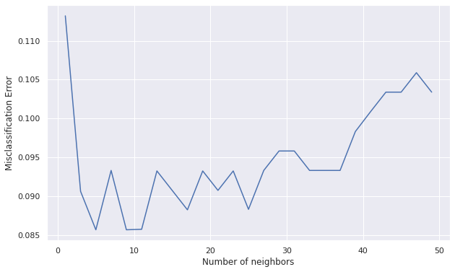
Breast Cancer Dataset
Step 1: Build the Models
 | Mean AUC Score | Accuracy Score
Random Forest Classification | 98.922 | 97.076
K-Nearest Neighbors | 96.108 | 94.737
Logistic Regression | 99.352 | 98.2456
K-fold | 95.251
Support Vector Machine (SVM) | 83.095
Optimal k for KNN was 5
Lasso reduced features from 30 to 25

Slide 4
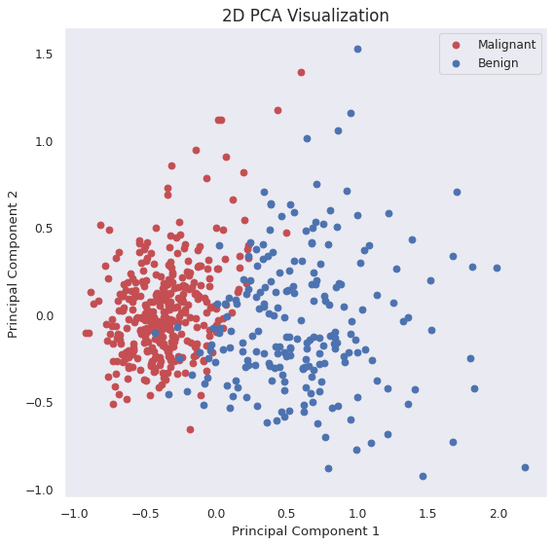
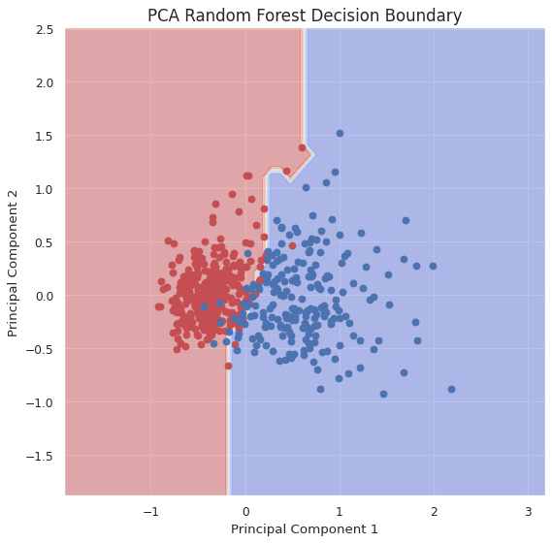
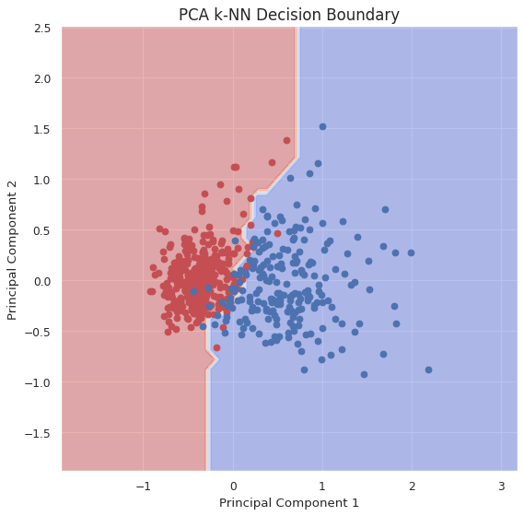
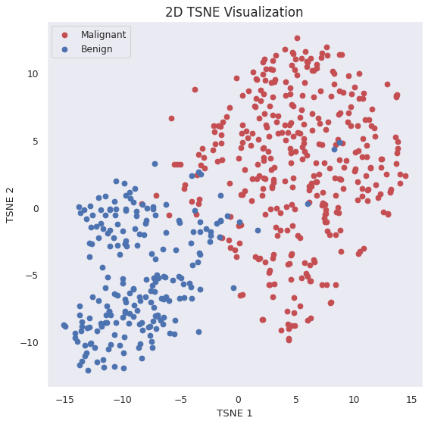
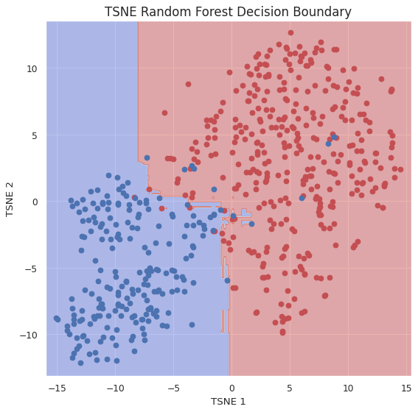
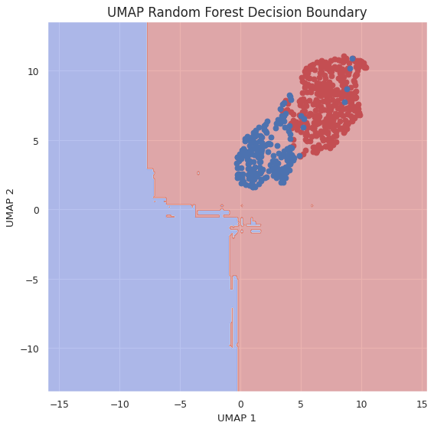
Breast Cancer Dataset
Step 2: Dimensionality Reduction
PCA identified 6 features that explain 90% of the variance in our data
Running again a Random Forest Classifier using the set of 2 features constructed by PCA (instead of the whole dataset) led to 94% classification accuracy
Running a k-NN Model using the set of 2 features constructed by PCA (instead of the whole dataset) led to 91% classification accuracy
Running again a Random Forest Classifier using the set of 2 features constructed by t-SNE (instead of the whole dataset) led to 95% classification accuracy
Testing our Random Forest accuracy using the t-SNE reduced subset confirms that now our classes can be easily separated.
Running again a Random Forest Classifier using the set of 2 features constructed by UMAP (instead of the whole dataset) led to 94% classification accuracy

Slide 5
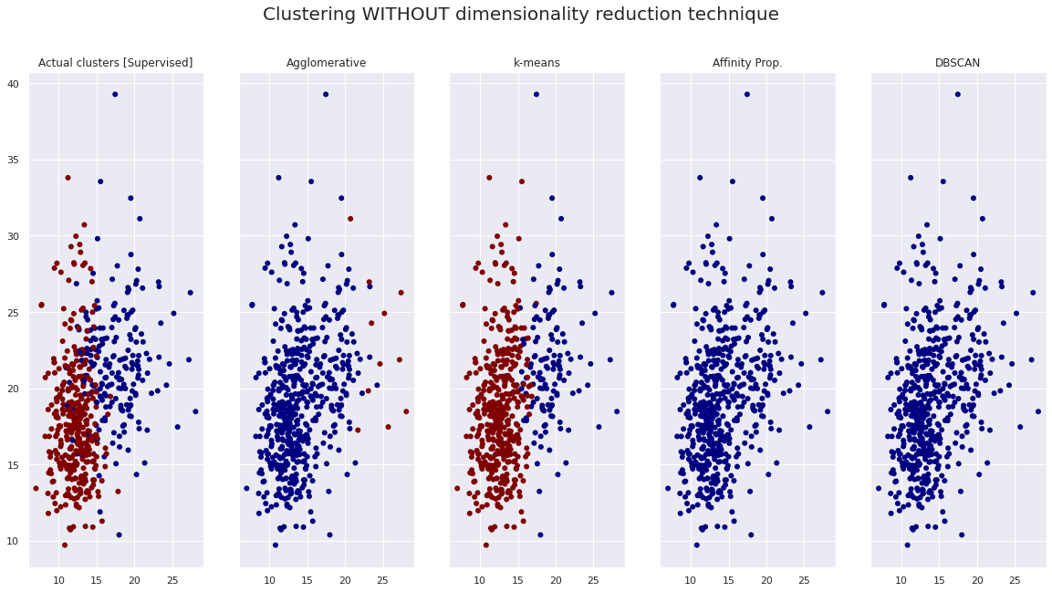
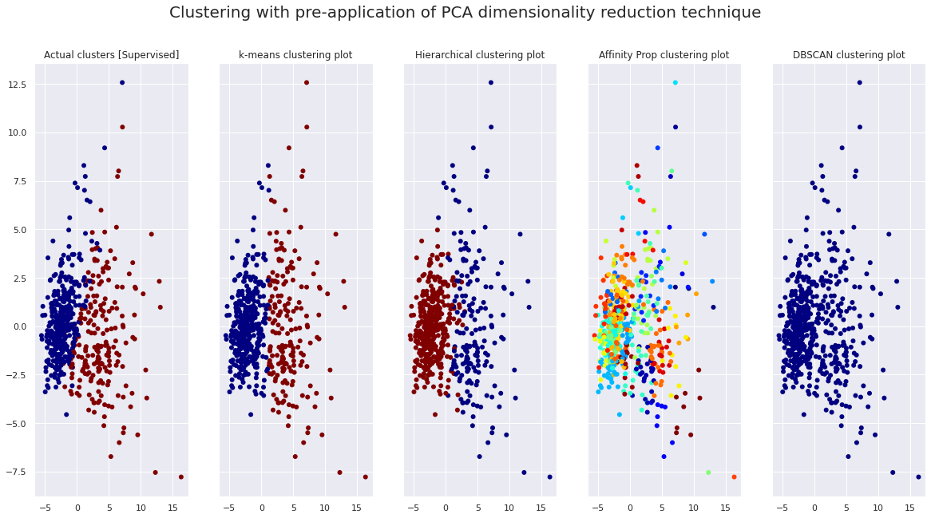
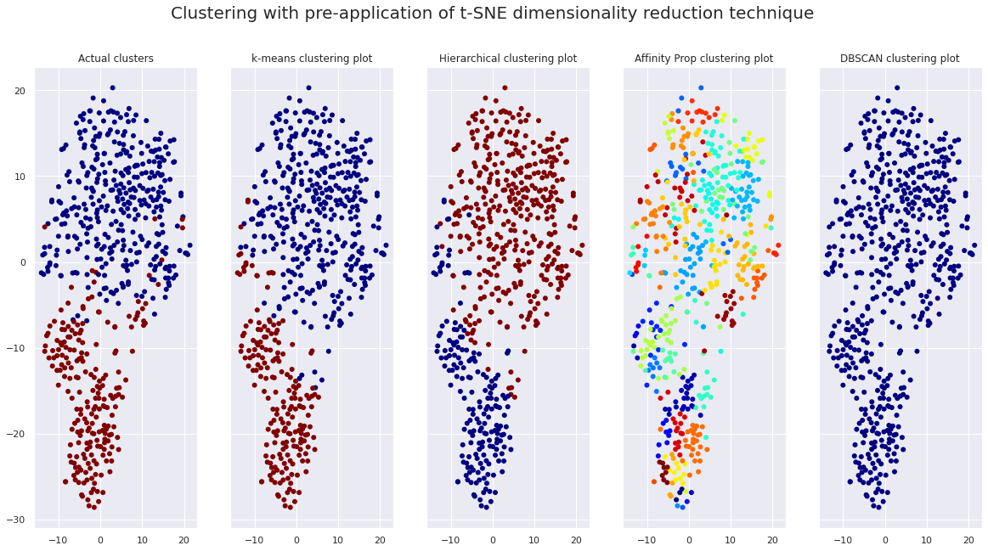
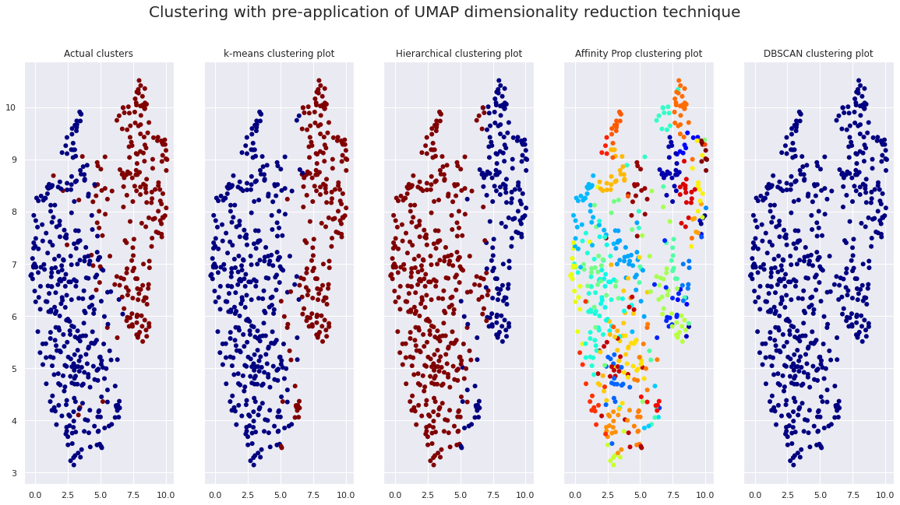
Breast Cancer Dataset
Step 3: Clustering

Slide 6
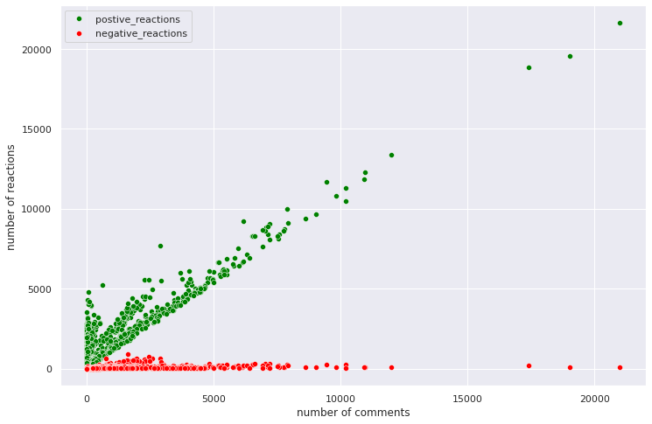
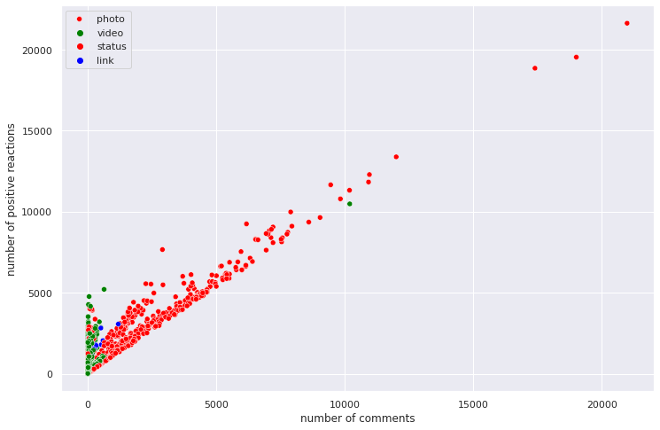
Facebook Metrics Dataset
Step 0: Cleaning, Visualization and Exploratory Analysis for Machine Learning
Dropped column1, Column2, Column3, Column4
Dropped duplicates
Used Encoding to convert the status_type column to a category of numeric values
The num_reaction column was a sum of the columns: num_likes, num_loves, num_wows, num_hahas, num_sads, num_angry. It was therefore dropped
Tried to see if there was a correlation between number of comments and positive and negative reactions, but it did not help.
Dropped status_id, status_published columns to limit features to 9
Truncated the number of rows to 1000

Slide 7
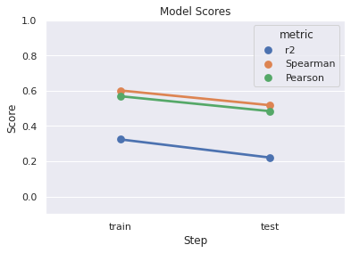
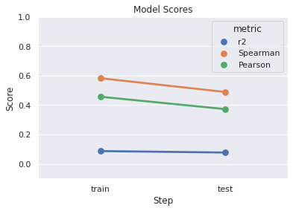
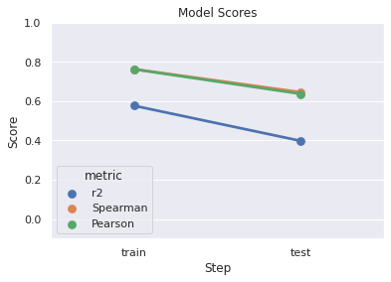
Facebook Metrics Dataset
Step 1: Build the Models
To remove the outliers, I removed any data points (rows) that were above the 90th percentile.
I used ‘num_likes’ as the output variable
Linear Regression
Based on the score for R2, the linear regression model with lasso regularization performed overall.
R2 value didn't go up from train to test, which makes me believe there was no overfitting.
Random Forest
We have decent performance with training set with Spearman and Perason
Model shows signs of overfitting - steep drop in score from train to test
Not much improvement was obtained by running a Random Forest model with the top four features
Summary
The linear regression model modestly outperformed the Random Forest model, yet neither could be a suitably performing production model. This suggests that the information in this dataset does not contain enough useful information.

Slide 8
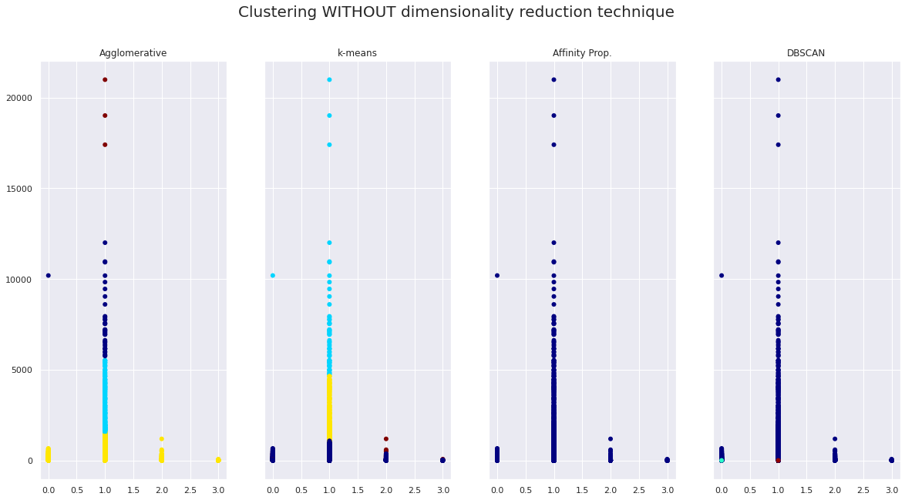
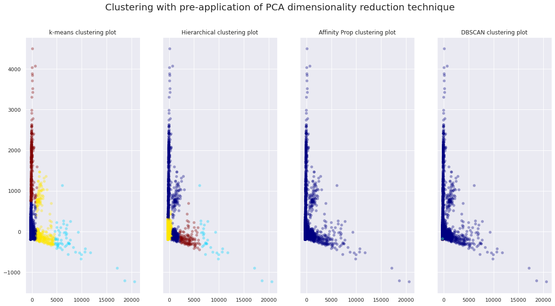
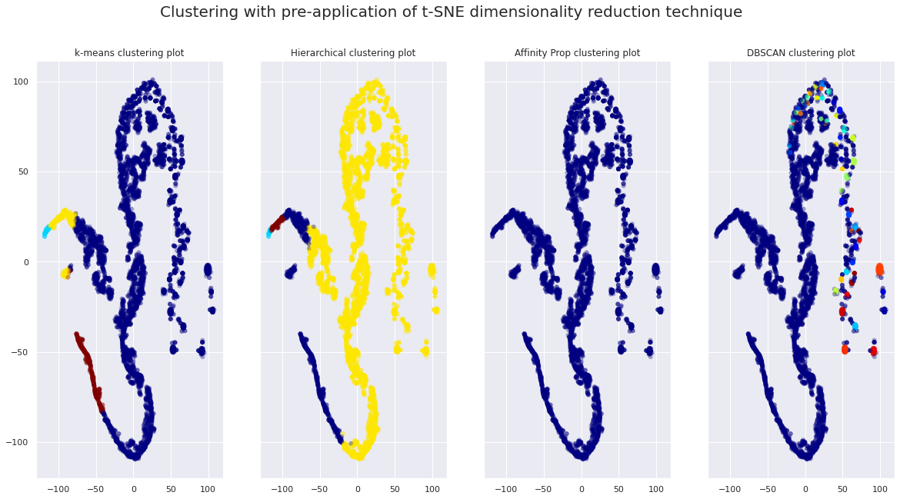
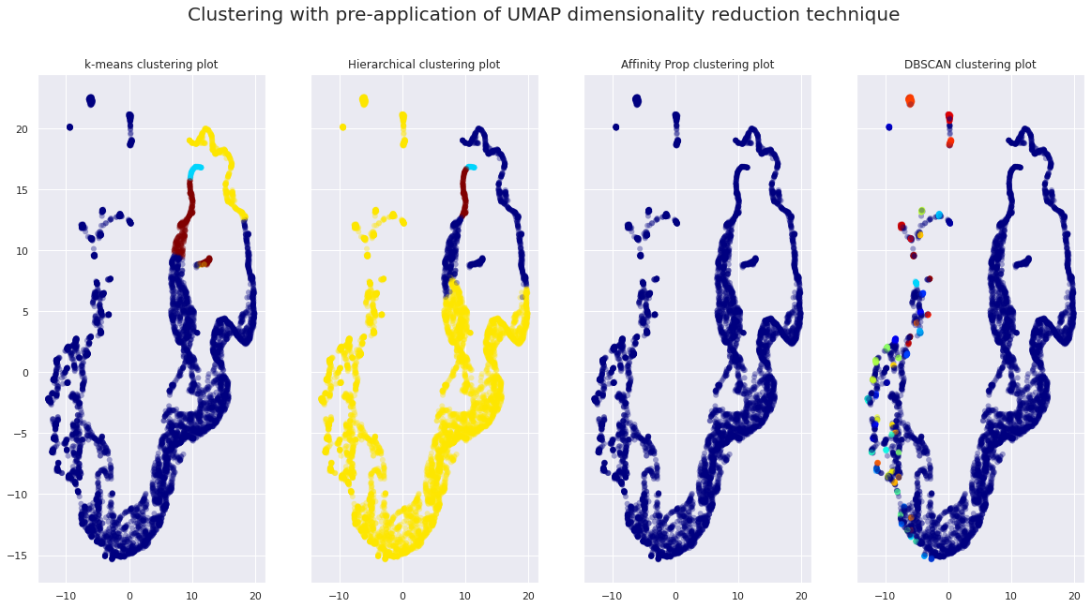
Facebook Metrics Dataset
Step 3: Clustering

